Slide 1
The Idea: Let’s Celebrate!
Community Defined Challenge Idea
Social Media and Virtual Outreach Celebration to build the Cardano and ADA brand
Specifically connected with the birthday of Ada Lovelace - December 10th
Coordinated Groups & Planned Actions
Ideally, let’s go outside our bubble, have fun, do something strange, out of comfort zones - Haiku anyone?
This is not a proposal for fund 3, but an attempt was made to use the example formatting mentioned in the last TownHall
Open to all, let’s re-engage, recreate the synergies from the Roadmap and the Start of Fund2 - Please comment, make it your own
Announce to the world that ADA has landed, and her pals Gogeun, Voltaire, Marlowe
Are on their way

Slide 2
Challenge formatting
Challenge title | Community Defined Challenge Sample - Celebrating Ada Lovelace
Challenge question | How can we throw a global virtual party for Ada Lovelace on December 10th, make it a “holiday” party, a Year End ‘Hoorah”, a chance to celebrate and showcase accomplishments and implement the roadmap?
Why is the challenge important | This challenge is important because it allows everyone that wishes to participate a chance to explore the highest potential of human collaboration, but past and present.
Metrics to measure success | Social Media Metrics: FB/IG/LI/YT/TW-Top 10 Twitter Trends, How many hours in Top 10, Number of Participants, #NewProfilePic - SMM, SoLoMo Micro-Challenges aligned with Roadmap Themes/Missions LunarCrush Community Growth
Challenge amount | Virtual hugs and high fives

Slide 3
Innovation Problem Statements
Problem Statement | How can the cardano community use this time before voting to engage with one another and implement the “roadmap”
Who will benefit from the solution? | The community, the proposers of Fund2, the individual contributors, stakeholders, teams, and people that do not yet know about Cardano
What is being accomplished? | Strengthening our bonds, our mission, performing actions on the roadmap, auditing the roadmap, specifically columns D, E,F, G
What is needed? | Participation

Slide 4
SOLUTION AND SUCCESS
What does Success Look Like? Successful Outcome - Drawing and /or Narrative
Increase in Community members, Spreading the Cardano brand globally, more developers, more businesses and entrepreneurs. Engage with groups and networks outside of our bubbles and introduce this to Cardano Branded Campaign, Everyone change profile pic/background/banner to ADA,

Slide 5
NEEDS AND WANTS
Existing Solutions | Pros | Cons
A
B
C
D
Rephrased Problem Statement based on Inventory of Pros/Cons with existing methods

Slide 6
Solution Notes
Beyond Calculation: The Poetical Science of Ada Lovelace
Who: Open Invitation to All, Open-House
What: Promoting and Celebrating the life of Ada Lovelace through a Unified Social Media Campaign
Where: Social Media, Twitter, Facebook, Reddit, LinkedIN, Meet-Up, EventBrite, any and all mediums welcome followed by a virtual “happy-hour” meet-up on the 10th.
When: December 10th, 2020, Exact time TBD
Why: Promotion of Cardano and ADA outside our community, Community Challenge Exercise, Fund2 Challenge - Introducing Project Catalyst: https://www.youtube.com/watch?v=Xa2HZ5kuKp4
How: Create Unified messaging and content and specifically try to engage with communities outside of the crypto/blockchain community.
Trending Twitter Hashtags: #ADA/$ADA #ADAKING, #ADALOVELACE @ideascale, #ideas #community #collectiveintelligence
Words below in bold are possible options
I.e - https://old.reddit.com/r/haiku/ - Haiku for Ada, referencing Basho; Call for Poems

Slide 7
ABOUT ADA LOVELACE
Augusta Ada King, Countess of Lovelace was an English mathematician and writer, chiefly known for her work on Charles Babbage's proposed mechanical general-purpose computer, the Analytical Engine https://g.co/kgs/4X3XQJ
She is believed by some to be the first to recognise that the machine had applications beyond pure calculation, and to have published the first algorithm intended to be carried out by such a machine. As a result, she is often regarded as the first to recognise the full potential of computers and as one of the first to be a computer programmer.^{[2][3][4]}
Her educational and social exploits brought her into contact with scientists such as Andrew Crosse, Charles Babbage, Sir David Brewster, Charles Wheatstone, Michael Faraday and the author Charles Dickens, contacts which she used to further her education. Ada described her approach as "poetical science"^{[8]} and herself as an "Analyst (& Metaphysician)".^{[9]} https://en.wikipedia.org/wiki/Ada_Lovelace
Words in Bold are possible hashtags and should be accompanied with #hashtags of groups/communities that may not know about cardano, blockchain, and/or crypto

Slide 8
Continued
“Far be it from me, to deny the influence of ambition and fame. ... I certainly would not deceive myself or others by pretending that it is not a very important motive and ingredient in my character and nature. AAL8 "
BBC DOCUMENTARY:
Calculating Ada - The Countess of Computing 2015
https://www.youtube.com/watch?v=QgUVrzkQgds
https://www.youtube.com/watch?v=2M_HLTHiWEY
Cardano Foundation Fireside Chat 2020

Slide 9
Notes

Slide 10
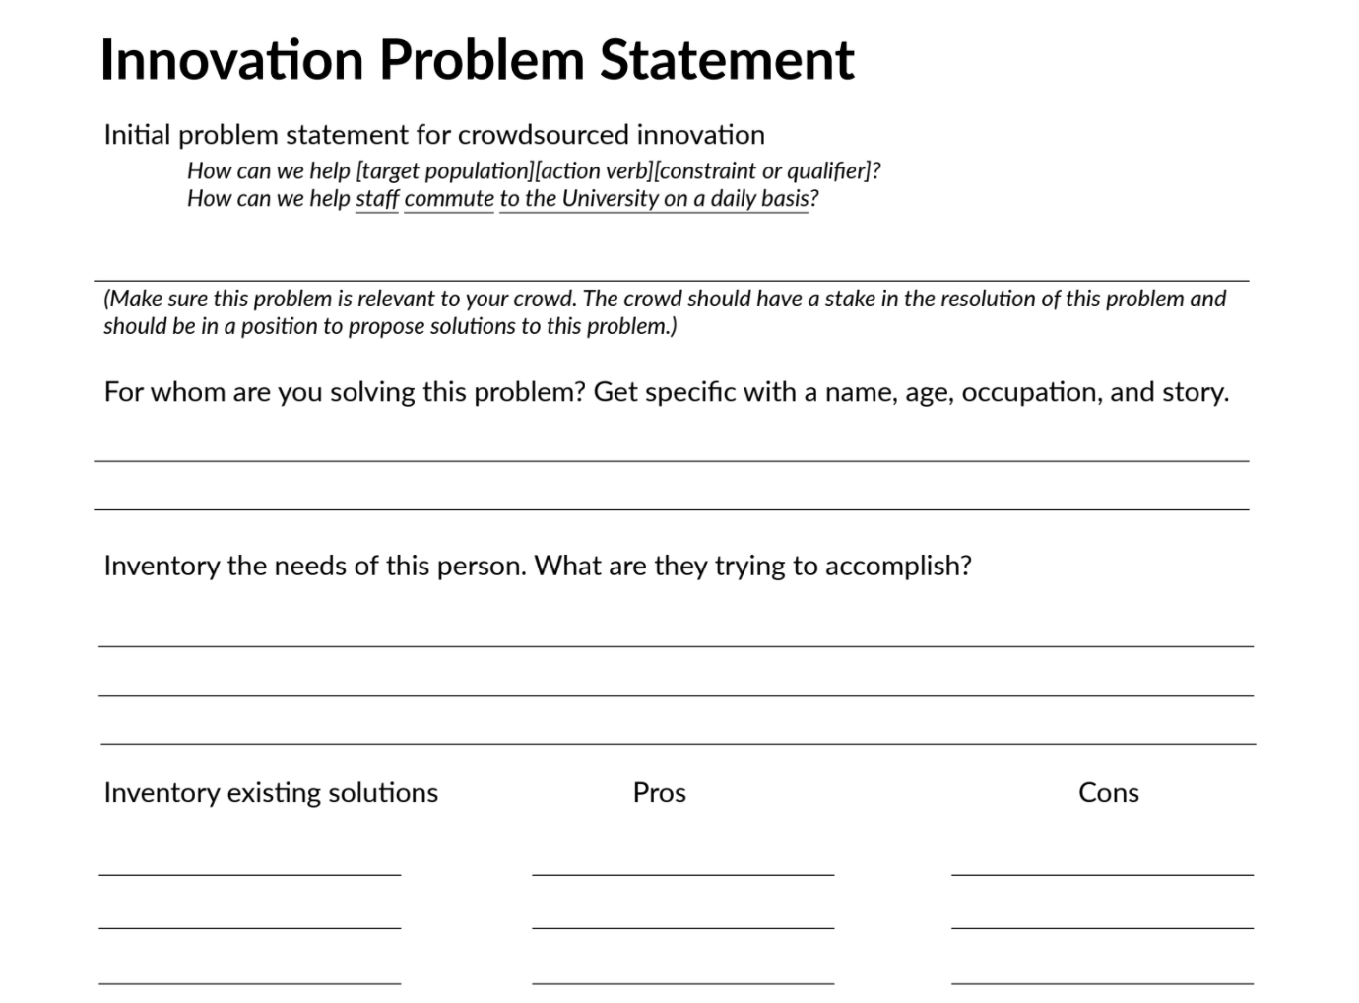

Slide 11
